Slide 1

Analyzing Patterns in Shark Attack Incidents: A Global Perspective
Team Red Members
Courtney Cole
Mohamed Ibrahim
Albert Lee
Jay Singh
Date: May 2, 2024

Slide 2


Slide 3
Introduction
Project Overview: The main goal of this project is to examine various aspects of shark attacks, including the time of year they are most likely to occur, the species of sharks most involved, the human activities that might lead to attacks, and the geographic locations where attacks are most frequent.
Why Sharks? Have you ever watched Jaws?
Presentation Agenda:
Intro
EDA &
Cleanup
Research Questions
Summary & Findings
Limitations & Future Research
Conclusion & Questions

Slide 4


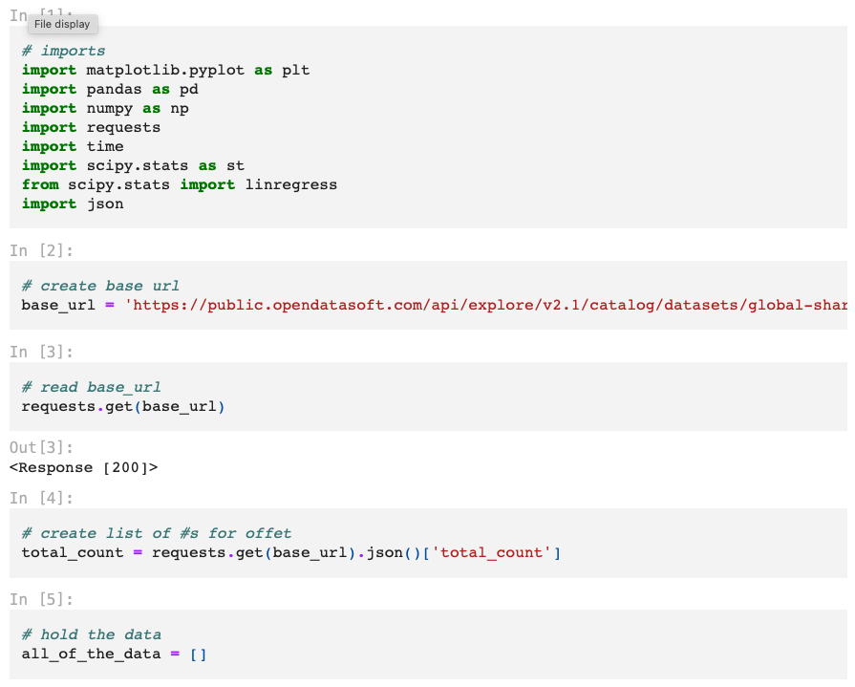

Exploratory Data Exploration and the Cleanup Process
Go to
main
Data Source: Global Shark Attack Dataset URL
Task List:
Tools:
API Data Retrieval
Data Pre-Processing
Data
Analysis
Conclusion
Summary
Data Visualization

Slide 5

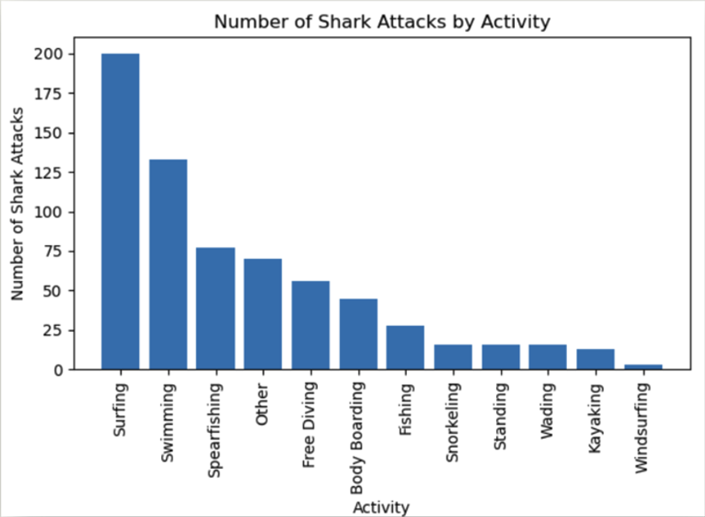
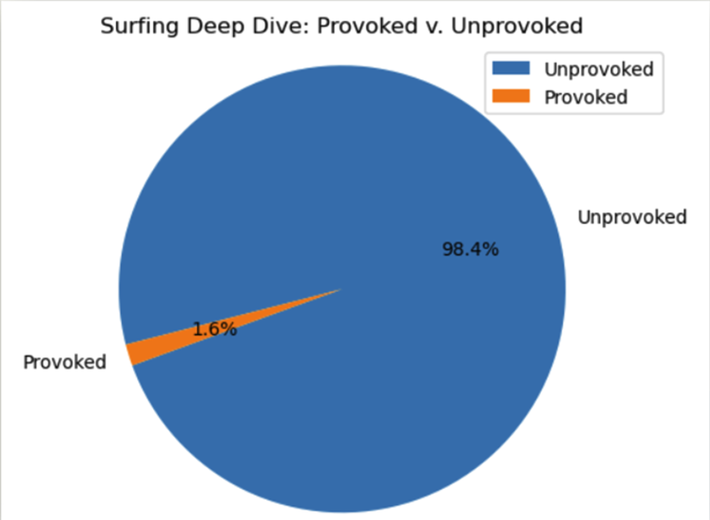
Activities Leading to Attacks: Is there a relationship between certain activities and the likelihood of an attack?
Go to

Slide 6

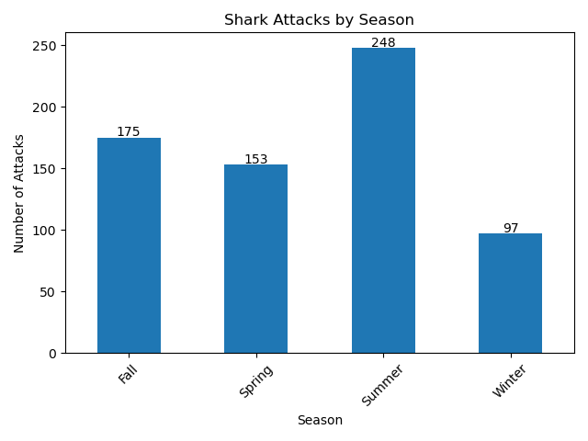
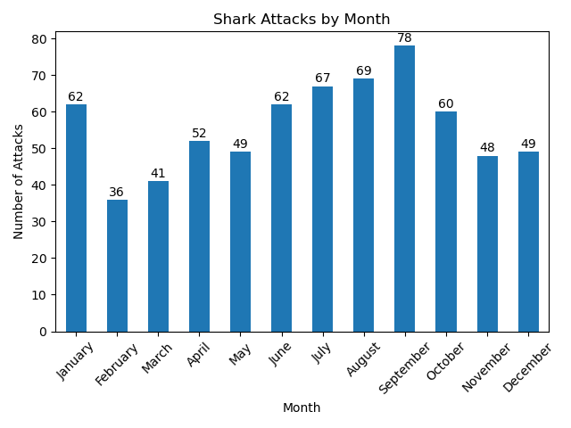
Seasonal Patterns: Are attacks more frequent during certain months or seasons? (1 of 2)
Go to

Slide 7
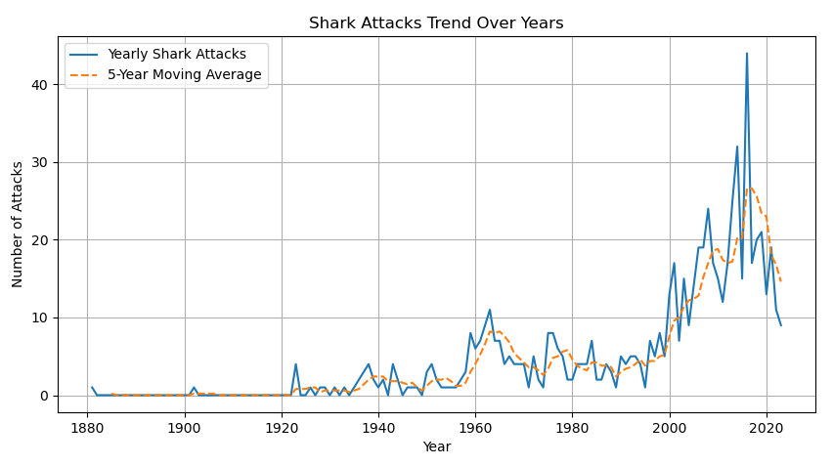
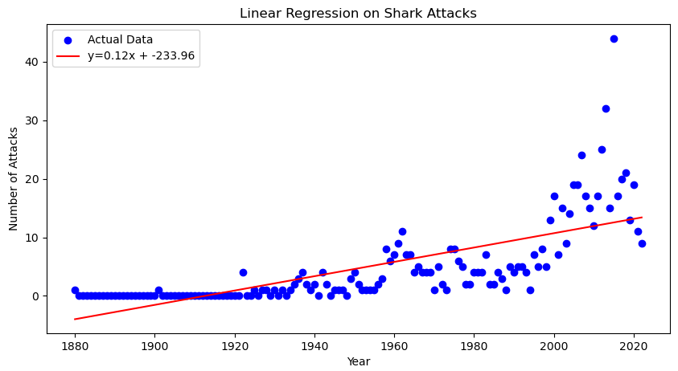
Seasonal Patterns: Are attacks more frequent during certain months or seasons? (2 of 2)
Go to

Slide 8

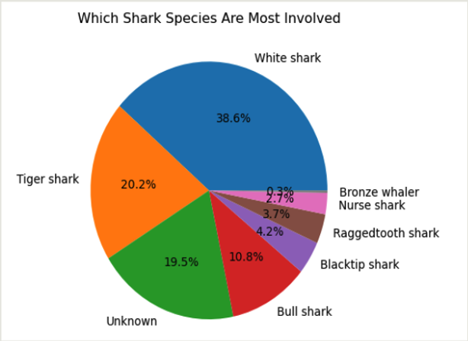
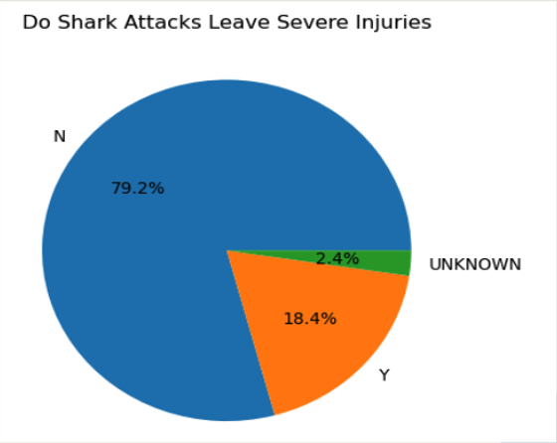
Species Involvement: Which shark species are most involved in attacks, and are some more likely to cause severe injuries?
Go to

Slide 9

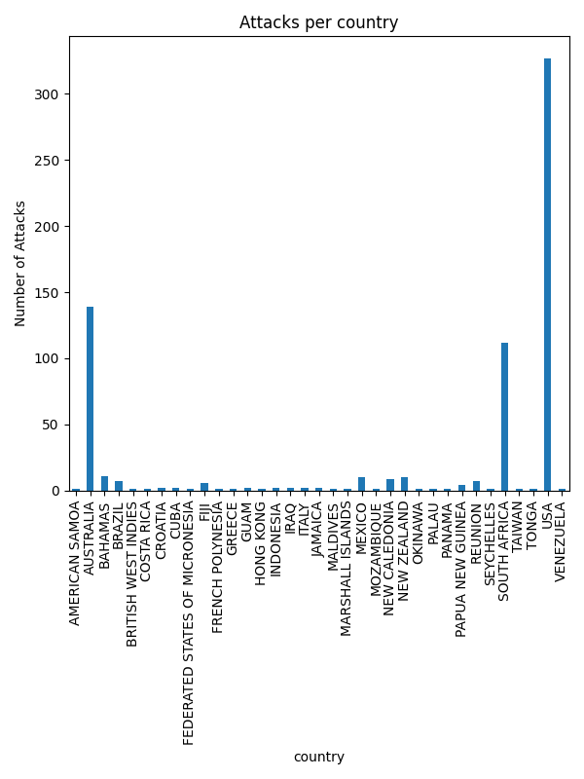
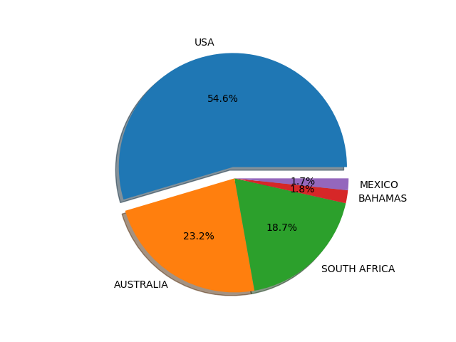
Geographic Hotspots: Which locations are more prone to attacks, and why? (1 of 2)
Go to

Slide 10
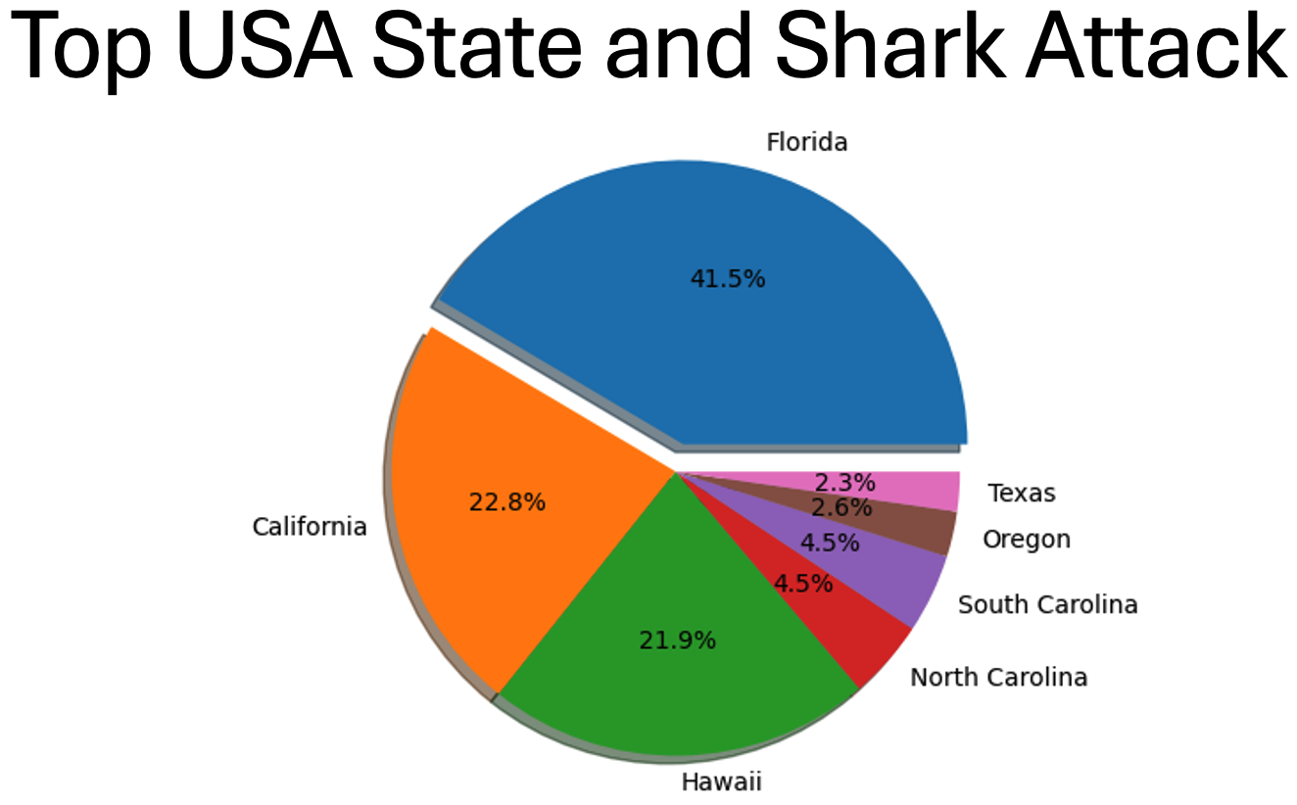
Geographic Hotspots: Which locations are more prone to attacks, and why? (2 of 2)
Go to

Slide 11
Summary of Findings
Activity and Risk: Surfing, swimming, and spearfishing are activities with the highest shark attack incidents, underlining a clear correlation between time spent in shark-prevalent waters and the likelihood of attacks. Surfing alone accounts for 200 attacks, significantly influenced by the extended periods surfers spend in the surf zone.
Shark Species and Behavior: White Sharks, Tiger Sharks, and Bull Sharks are most frequently involved in attacks, attributed to their aggressive tendencies and human-like prey confusion. Specifically, White Sharks lead with 38.6% of attacks, illustrating their dominant presence in coastal regions frequented by humans.
Seasonal Variations: Shark attacks peak during the summer months, aligning with increased human activity in coastal waters. The highest monthly attack rate occurs in September with 78 incidents, emphasizing the seasonal rise in interactions during warmer periods.
Severity of Injuries: The majority of shark attacks (79.2%) do not result in severe injuries, suggesting that while shark encounters are dangerous, they often do not lead to significant harm. Effective and immediate medical responses post-attack play a crucial role in minimizing injury severity.
Historical and Temporal Trends: Over time, shark attacks have shown a general increase, particularly highlighted from 2000 to 2015, correlating with heightened global tourism and better data collection. However, recent years have seen a decline, possibly due to improved safety measures and changing environmental conditions.
Geographic Hotspots: The United States, Australia, and South Africa are the primary geographic hotspots for shark attacks, collectively hosting over 96% of reported incidents. Within the USA, Florida is particularly noteworthy, accounting for 41.5% of the nation's attacks and approximately 23.6% of the shark attacks when considering the combined total from the USA, Australia, and South Africa. This is indicative of Florida's extensive coastline and high beachgoer presence. These regions are characterized by robust beach cultures, active marine recreational activities, and effective incident reporting systems, all of which contribute to the high incidence rates and ongoing efforts to mitigate shark-human interactions.

Slide 12
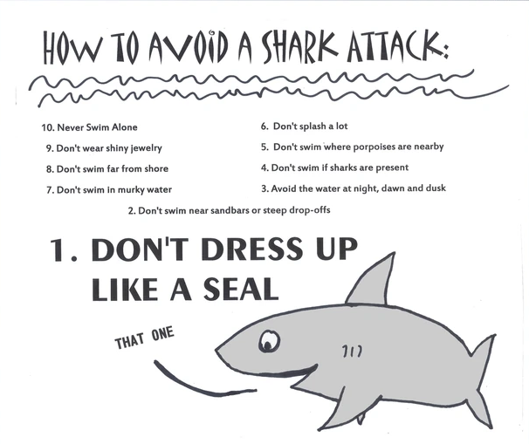
Limitations and Areas for Future Research
Future Research:
Enhanced data collection (time of day, precise location data)
Human activity patterns (water sports, tourism)
Climate change effects
Technological and preventive measures
Limitations:
Incomplete data
Data granularity and quality
Did not consider external factors

Slide 13
Conclusion
Targeted Safety and Awareness: Recognizing high-risk activities like surfing, swimming, and spearfishing is vital for the development of targeted safety measures and educational programs. Geographic hotspots, particularly in the USA, Australia, and South Africa, with Florida being a significant contributor, necessitate specific strategies that cater to their unique circumstances and high incidence rates. Developing comprehensive policies and launching awareness campaigns in these regions are crucial steps towards mitigating risks, enhancing beach safety, and educating the public about shark behavior.
Species-Specific Strategies: The predominant involvement of specific shark species such as White Sharks, Tiger Sharks, and Bull Sharks in attacks provides critical information that should guide the development of public safety strategies and conservation efforts. By understanding the behaviors and patterns of these species, policymakers can craft more effective responses that could help in reducing both the frequency and severity of shark attacks.
Seasonal Patterns, Medical Response, & Safety: The seasonal increase in shark attacks during the warmer months and the overall upward trend highlight the urgent need for robust safety protocols. Enhancing lifeguard services and emergency medical responses during peak periods is crucial, especially in high-risk areas such as the USA, Australia, and South Africa. By improving resource allocation and on-site medical capabilities at beaches, we can significantly mitigate the impact of shark attacks and ensure quicker, more effective treatment of injuries when they occur. This integrated approach not only addresses the temporal fluctuations in shark activity but also reinforces the overall safety infrastructure for beachgoers.

Slide 14


